Slide 2
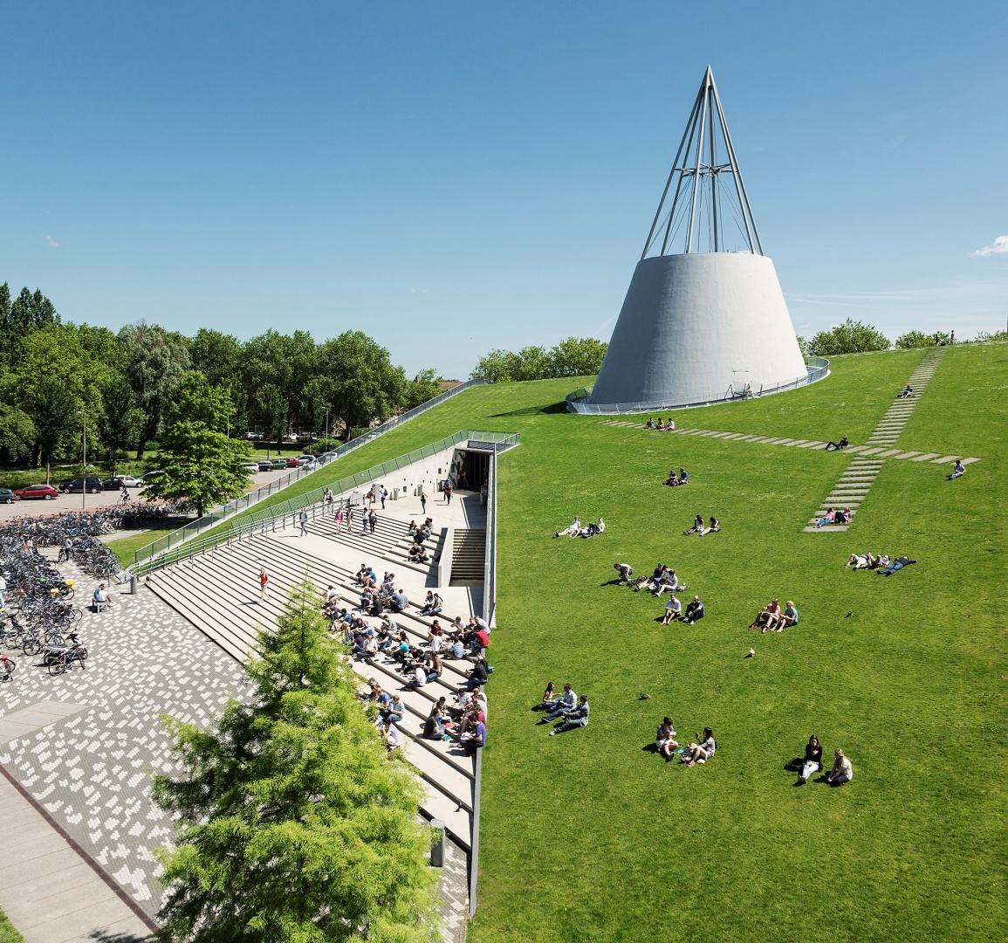
System & Model
Mismatch in Supply Chain
Group 6

Slide 3
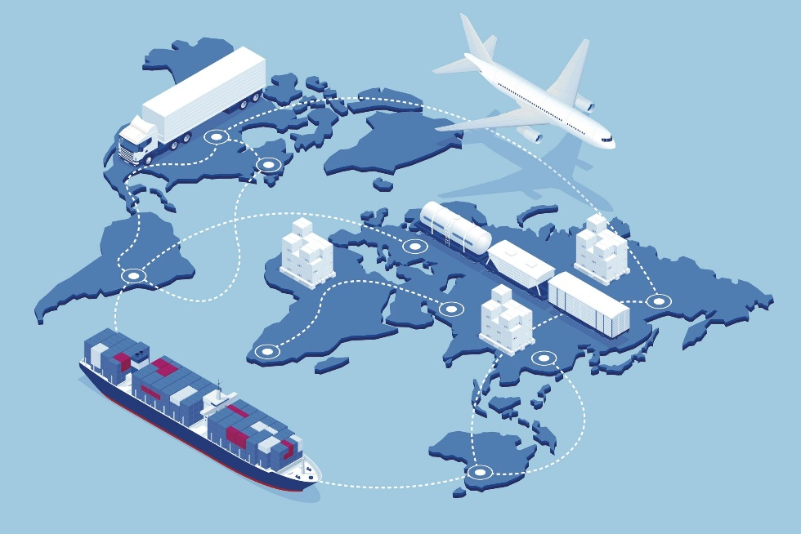


Mismatch?
Ackoff: there is one very large contributing factor to all of them: the way these systems are conceptualized, modeled. There is a very serious mismatch between most social systems and the models of them that are in use.
NO MODEL IS RIGHT
ABM
DES
SD
Loss of information
What do we care about?
Model
Do we use the right model?
Supply Chain
Ackoff, R. L., & Gharajedaghi, J. (2003). On the mismatch between systems and their models.
Source: https://www.sourcemap.com/blog/what-is-supply-chain-mapping
09-10-2020

Slide 4




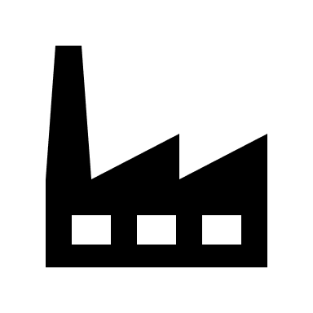


What is Supply Chain?
 | Deterministic | Animate | Ecological | Social
Part | No Choice | No Choice | Choice | Choice
Whole | No Choice | Choice | No Choice | Choice
Classification of system
Screen from Korea
WHOLE
Battery from China
Chip from America
Smartphone
Producer
In the Netherland
Assembled in Europe
Ackoff, R. L., & Gharajedaghi, J. (2003). On the mismatch between systems and their models.
09-10-2020

Slide 5
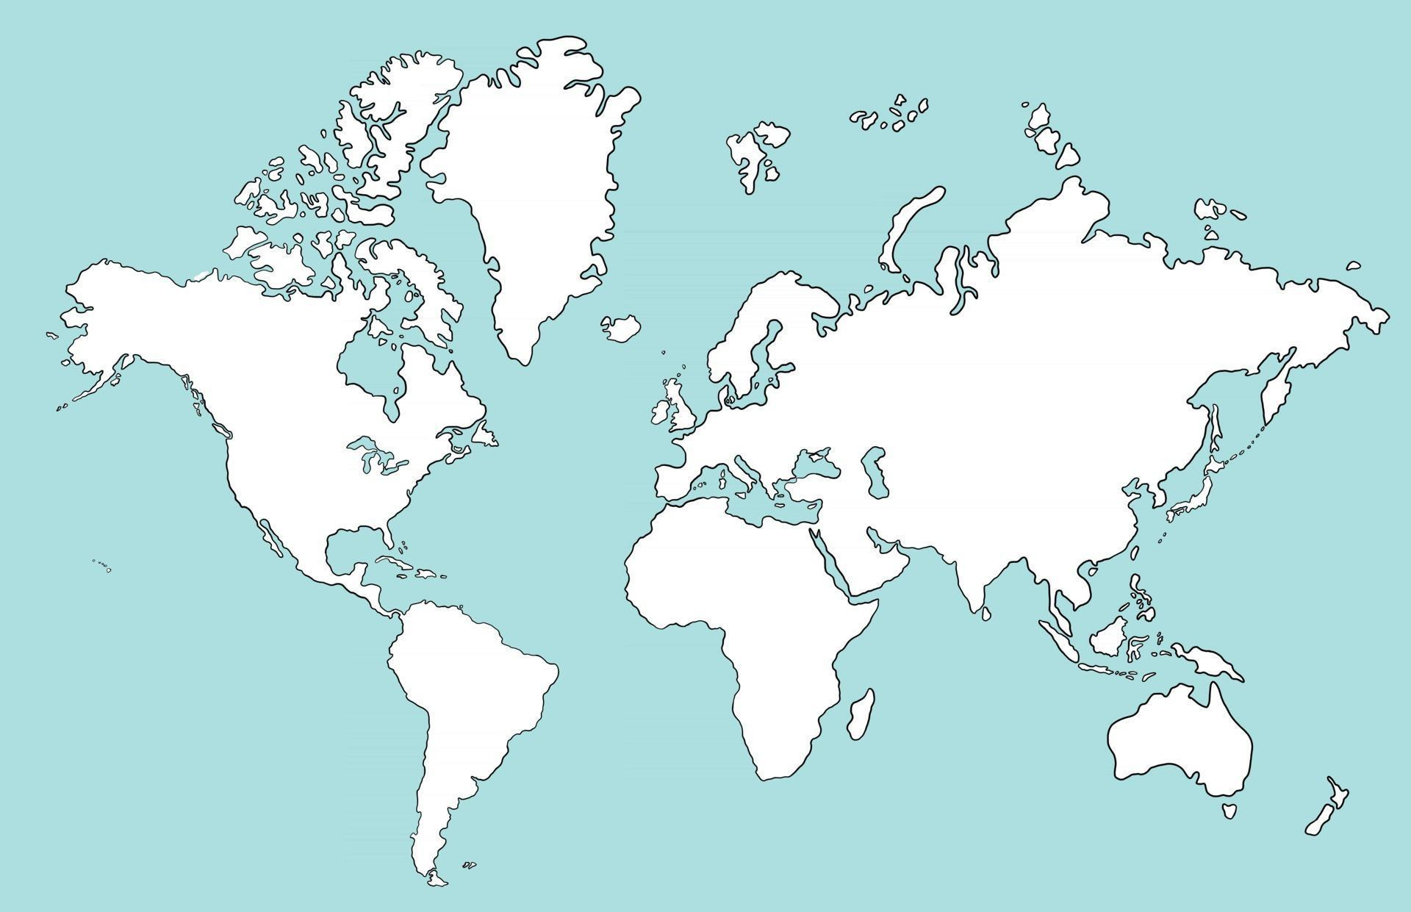


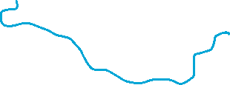



What is Supply Chain?
Parts
Logistic company
Material Producer
Headquarter
Assembling Factory
Warehouse
Do they have their own decision?
YES!
Social: Part and Whole both make choice

Slide 6
Long-term or Short-term Decision Making?
Find material suppliers
Find logistics companies
Find retailers
Set target groups (in which region)
Build a Supply Chain Network
We want to produce a new phone (development is done)
Supply Chain Network / Structure
Long-term (Strategic)
- Help!The phone turns out to be very popular in Australia, out of stock!
Inventory Scheme Change
More Short-term (Opertional)
Check the inventory scheme in Australia
we could change the inventory scheme (e.g. lift up the restock threshold)
Rarely change the existing network

Slide 7
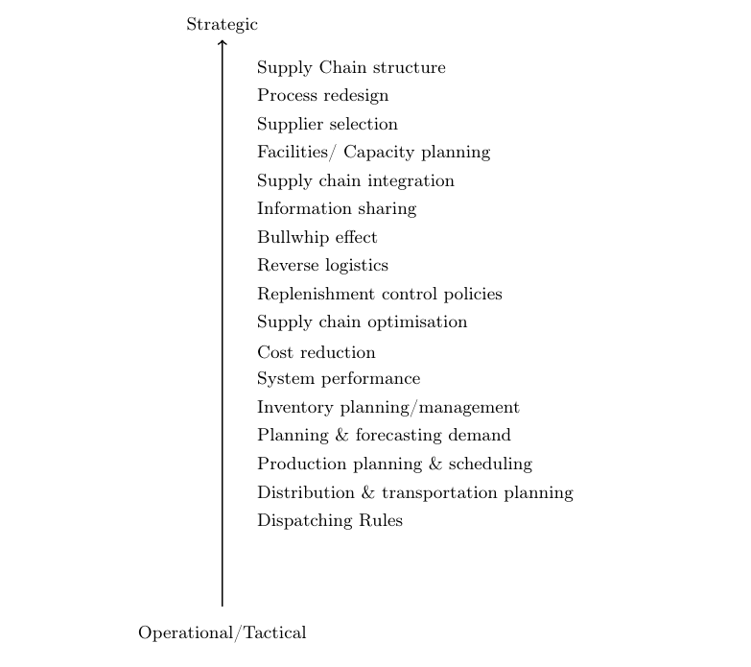
Ordering Supply Chain Issues
Using this ordering, we could classify them into a more social, ecological or deterministic-oriented issue.
The problem is too complex, but the system to be handled depends on our perspectives.
Supply Chain Structure: ignoring choices in both parts and whole, only caring about the network structure (determ.)
Bullwhip: dynamics of products flow, some details of choices in components could be left out.
Supply Chain Optimisation: focusing on optimization, but considering the effects of information exchange and their choices.
Production Planning: focusing on its daily performance, how much we need to produce, more ecological and social

Slide 8
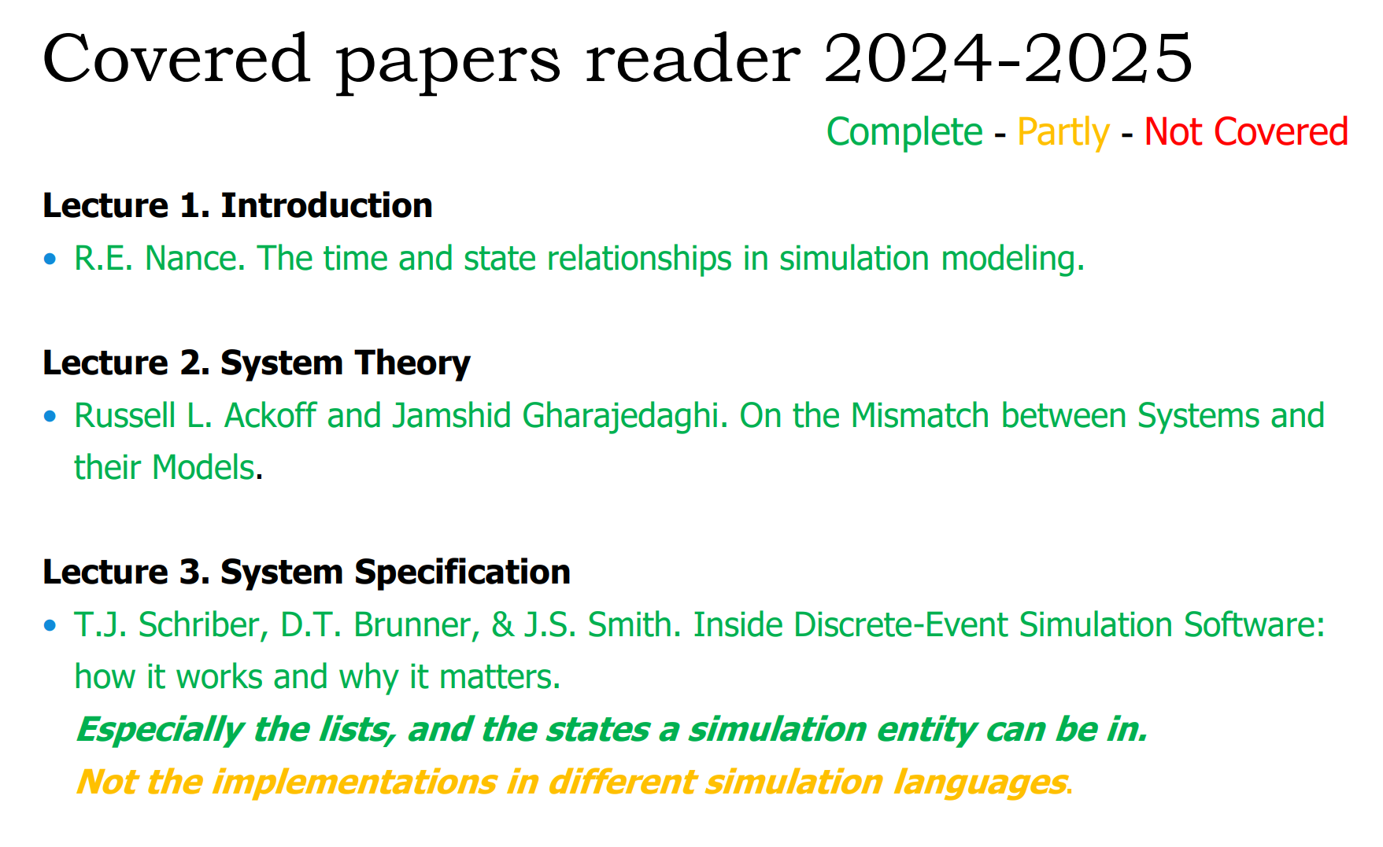
Exam helper! Mismatch Methodology
Worring about the coming EXAM?
Let's go through this exam paper heavily used in our term paper together!
Source: SEN9110 Exam 2024-2025

Slide 9
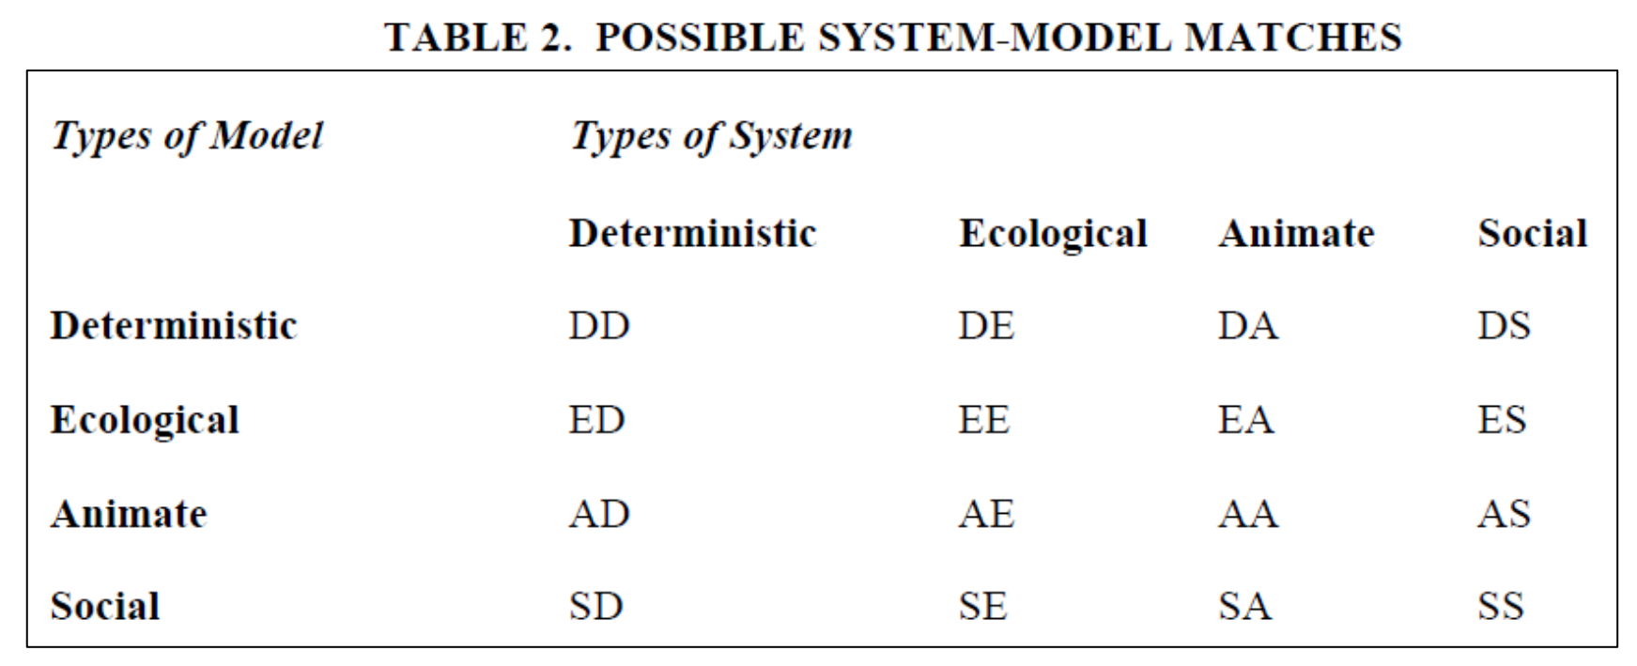
Exam helper! Mismatch Methodology
In the paper, as described in the previous slide, all the models and systems could be categorized in one of the four types: Deterministic
Ecological Animate Social
Therefore, if we count all the possible combinations, 16 combinations could be existing in the studies!
Source: Russell L. Ackoff and Jamshid Gharajedaghi, On the mismatch between systems and their models

Slide 10
Exam helper! Mismatch Methodologies
However, some of them are meaningful, the rest of them are not.
Ackoff conclude that:
When models of one type are applied to systems of a different type, at least as much harm is done as good.
Source: Russell L. Ackoff and Jamshid Gharajedaghi, On the mismatch between systems and their models
So for the answer of the question in the slides in section 2: which of those combinations are meaningful, I would say that only the combinations in the diagonal are 100% meaningful, as rest of them have at least as much harm is done as good,
however, the blue ones are bearable, at least they have some attributes in common

Slide 11
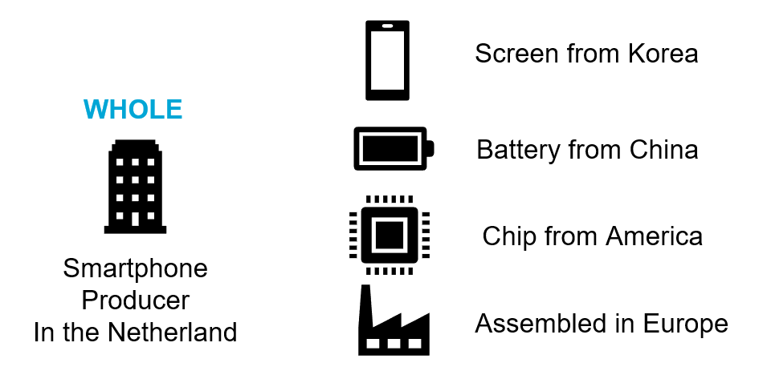
Case Study on Mismatch
Is the part of the system/model able to make choice?
Is the whole system/model able to make choice?
We also
have choices!
I have choices!
Discrete Event Simulation
Its individual parts (components or entities) within the model can make choices or react to events, while its whole are pushed forward by the individual parts, which means they have no choices!
Mismatch！
Social!
Ecological!

Slide 12
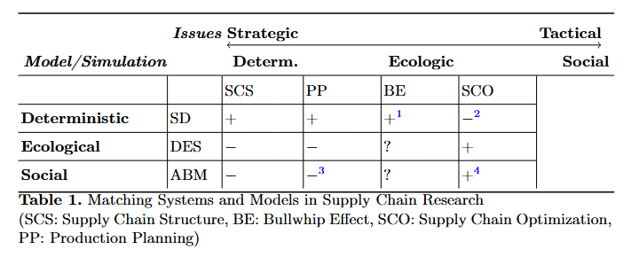
A Result From us!
We cannot stop at saying that the whole supply chain is social system of the previous example, we would have super simple results, only ABM can handle the Supply Chain System.😟
However, we focus on different issues in the supply chain system, gives us a chance to rich our content!😊

Slide 13
Thank you for your attention
Group 6

